Slide 1
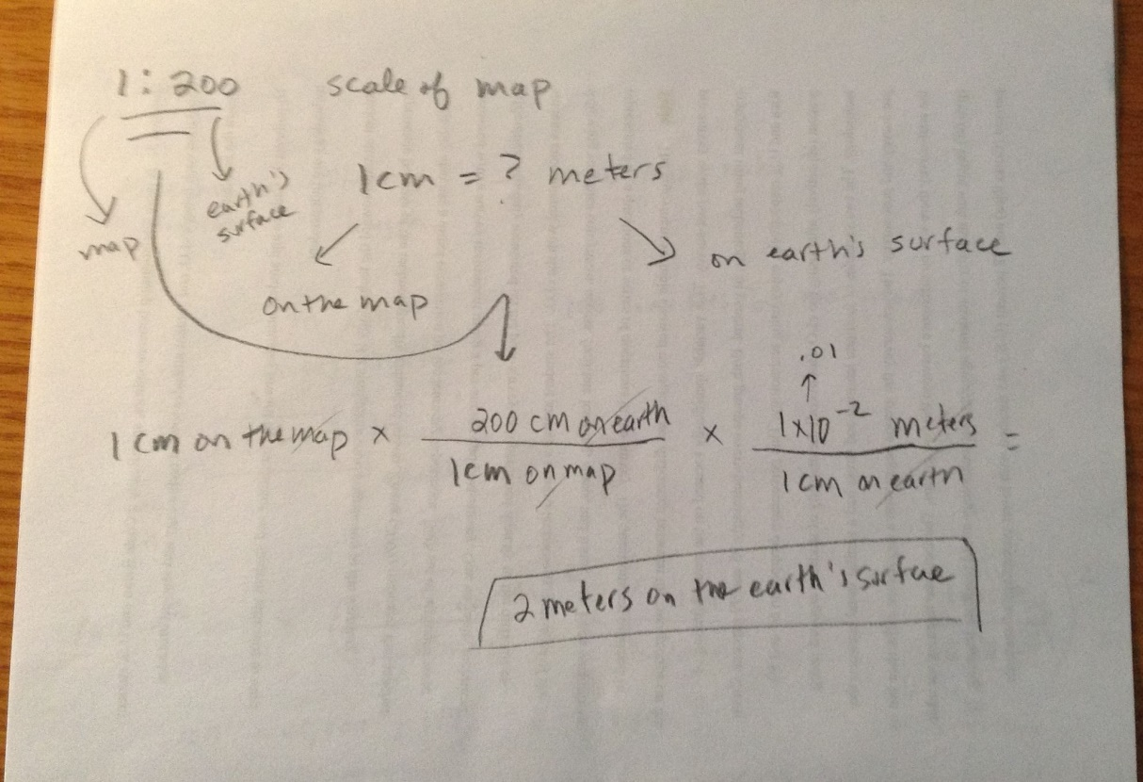

Fractional scale calculation

